Slide 1
Harvesting High Value Foreign Currency Transactions from EMV Contactless Credit Cards without the PIN
21st ACM Conference on Computer and Communications Security
Martin Emms, Budi Arief, Leo Freitas,
Joseph Hannon, Aad van Moorsel

Slide 2
Structure of presentation
Brief overview of EMV contactless payments
Overview of our work
Analysis methodology
High value foreign currency transaction flaw
Science / Vulnerability / Attack
Why it works
MasterCard vs Visa contactless protocol
Live Demonstration

Slide 3
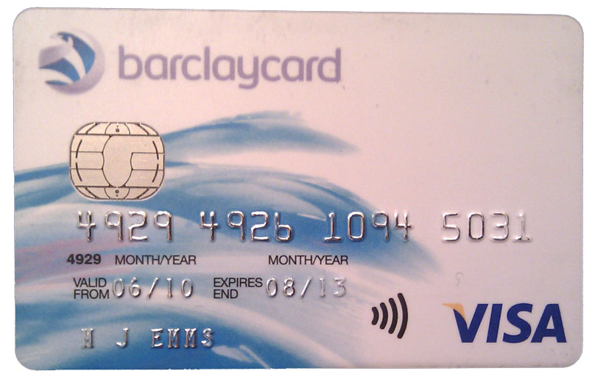
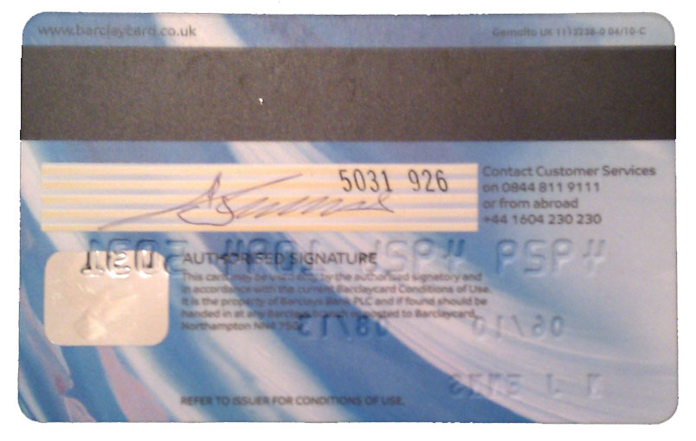
EMV Contactless Payments 101
Chip & PIN
Contactless
Magnetic Strip
Europay MasterCard Visa – “Chip & PIN”
Used in 76 countries worldwide
Dynamic transaction authorisation 3DES and RSA
Contactless payments
Fast / low value (£20) transactions - No PIN required
Offline transactions - No card issuer authorisation
Notes:
Contactless transactions are designed to be a quick and convenient way to pay for low value purchases ($20) such as coffee or lunch. To make the transaction faster there is no PIN required from the cardholder.
Make the card secure without the PIN entry; contactless is limited to 5 consecutive payments at £20 / $25 each.
Contactless transaction limits
USA $25 Australia $100 New Zealand $80
Europe €25 Ireland €15, UK £20

Slide 4
Overview of Our Work
Analysis of EMV contactless payment protocol
Contactless cards and mobile payments
Software emulation of the contactless protocol
Z abstract model of contactless protocol
Methodology establishes link between “real world” errors and the EMV specification
Bad implementation by card manufacturer
Fundamental flaw in the specification
Practical demonstrations for general public
Notes:
Overview of the objectives of our work
Its all about the protocol because if the EMV contactless card protocol is broken, that means payment systems such as mobile contactless payments are also broken as they use the same protocol.

Slide 5
EMV Payment protocol specification
14 books
2392 pages
1 Chip & PIN protocol
7 contactless protocols
Visa, MasterCard, American Express, JCB, UnionPay and Discover
Greater complexity
Greater potential for errors
Notes:
This is a very complicated specification...
Contactless made the speck much more complex as each of the card payment schemes (Visa, MasterCard etc.) now have their own contactless payment protocol whereas in Chip & PIN they all conformed to the single protocol.

Slide 6
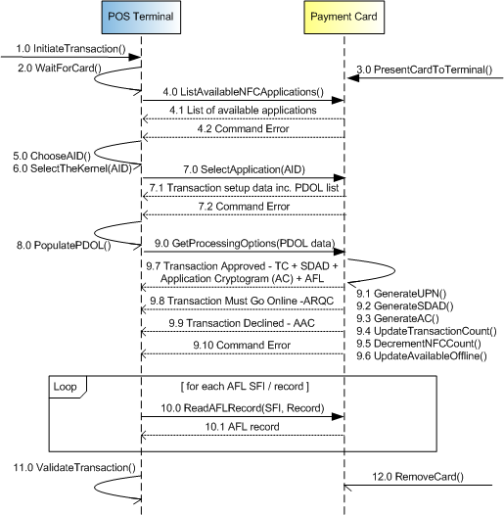
Analysis Method Interpreting the Specification
EMV Specification
References Tables
UML Diagrams
Notes:
This is how we make sense of the complicated specification.

Slide 7
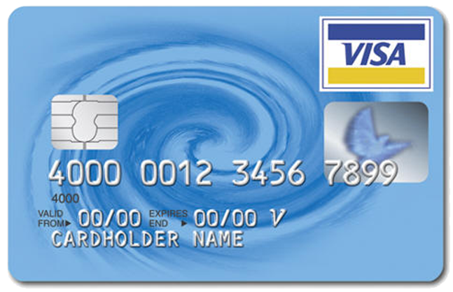
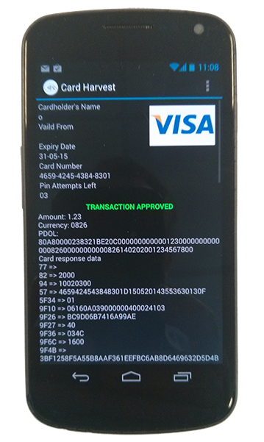
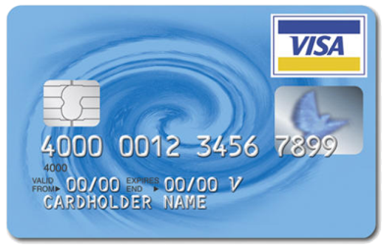
Analysis Method Modelling the Specification
Abstract Model (Z notation)
EMV Protocol Emulation
Anomalies
Test Cases
Results
Practical Demonstrations
Notes:
We have built an Abstract model in Z and a software model in Java (the emulator)
With these two we can investigate the robustness of the EMV protocol
When we find a theoretical flaw with the Abstract Model we can investigate it with the Protocol Emulator to see if it exists in the real-world implementations of credit/debit cards an/or POS terminals.
When a flaw in the specification is found we create a practical demonstration that (1) can be understood by the general public (2) shows that this is doable in the real-world and is not just an “academic exercise” as the banks like to claim. This enhances the impact of our work.

Slide 8
Documenting the Link Error ⬄ Specification
EMV Specification
UML Diagrams + Reference Tables
Practical Attack
Notes:
The methodology allows us to link the exploitable weakness back to the EMV specification. So where we have built a practical demonstration in Android we need to be able to say that this derives from our understanding in the UML diagram “here” which thru the table of references links back to the Book / Page and Section in the original EMV specification.
This allows us to show that this is not just a bad implementation by a particular card manufacturer or POS terminal vendor. This is actually a fundamental weakness in the specification.

Slide 9
Contactless Foreign Currency: The Science
Abstract Model for Visa fDDA transaction
Pre-conditions - Amount, Currency and Date
Transaction limit (£20) is in card’s home currency
Transactions above the limit require PIN entry
EMV Book 3 (version 4.3) page 163
“If transaction is in the application currency and is under X value” - (X = card transaction limit)
What if transaction currency != application currency?
Notes:
How did we discover the foreign currency flaw?
Transaction currency != Application currency is not specified so that lead us to ask the question what does the card do in that circumstance?
Card cannot store currency tables as they would be hopelessly out of date...

Slide 10
Contactless Foreign Currency: The Vulnerability
In a foreign currency, ALL cards say YES
Bypasses transaction limits
Max value 999,999.99 in any currency
Contactless transactions => NO PIN required
Attack can occur while card still in cardholders’ wallet
Visa fDDA contactless transactions are offline
No additional checks by the card issuer
“Chip & PIN is broken” shows Application Cryptogram is not checked by the card issuer
Notes:
Visa cards say YES - does not know so defaults to YES

Slide 11
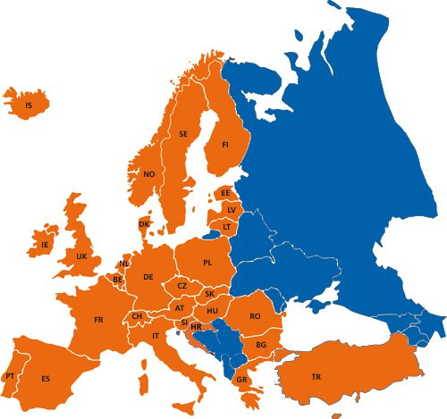
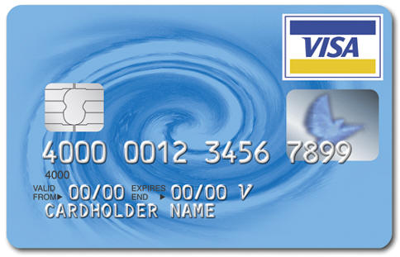
Contactless Foreign Currency: The Attack
Send Transaction
Victim’s Card
Rogue Merchant
€200
No PIN
Capture Transaction
Collect Funds
Store Transaction

Slide 12
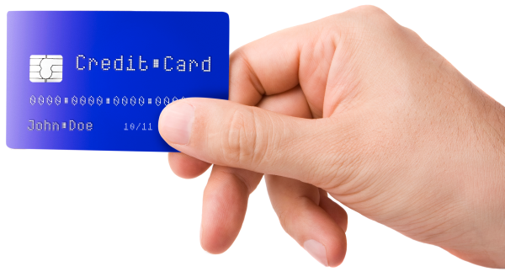
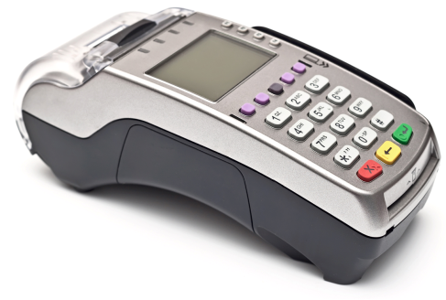
Why It Works: Chip & PIN Protocol
Select(Application)
Card Information
GetProcessingOptions()
AFL records list
ReadRecord(AFL)
Card public keys
GenerateAC(Transaction)
Auth Response Cryptogram (ARPC)
Verify(PIN)
OK / incorrect
GenerateAC(ARPC)
Application Cryptogram (AC)
Issuer Bank
POS terminal
Credit/Debit Card
ARQC
ARPC + ARC
Transaction + AC

Slide 13
Why It Works: MasterCard Contactless Protocol
Select(Application)
Card Information
GetProcessingOptions()
AFL records list
ReadRecord(AFL)
Card public keys
GenerateAC(Transaction)
Auth Response Cryptogram (ARPC)
Verify(PIN)
OK / incorrect
GenerateAC(ARPC)
Application Cryptogram (AC)
Issuer Bank
POS terminal
Credit/Debit Card
ARQC
ARPC + ARC
Transaction + AC

Slide 14
Why It Works: Visa fDDA Contactless Protocol
Select(Application)
Card Information
GetProcessingOptions(Transaction)
Application Cryptogram (AC) + AFL
ReadRecord(AFL)
Card public keys
GenerateAC(Transaction)
Auth Response Cryptogram (ARPC)
Verify(PIN)
OK / incorrect
GenerateAC(ARPC)
Application Cryptogram (AC)
Issuer Bank
POS terminal
Credit/Debit Card
ARQC
ARPC + ARC
Transaction + AC

Slide 15
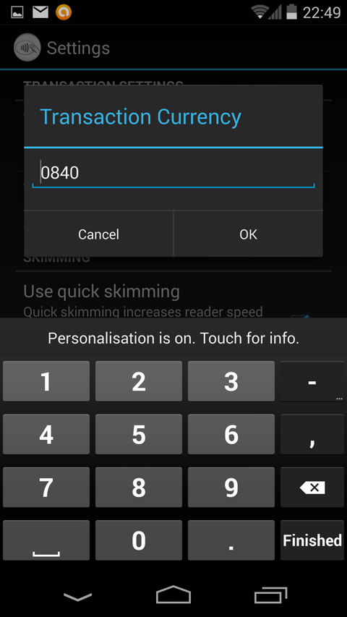
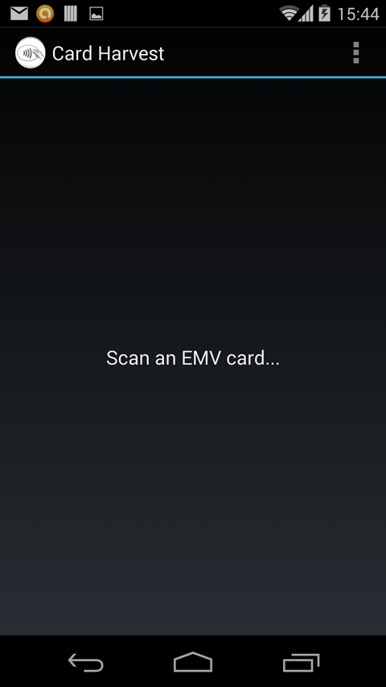
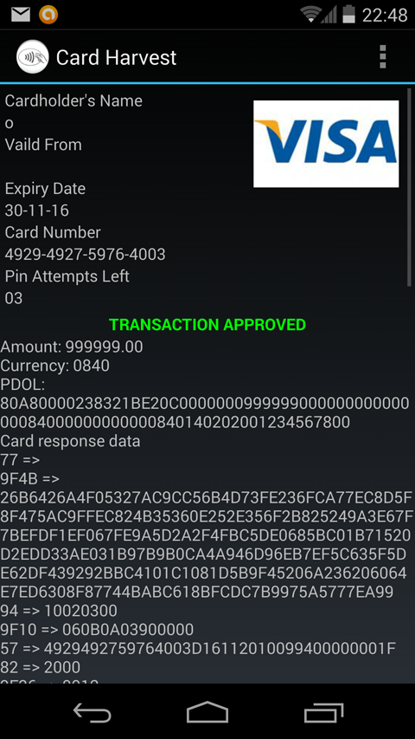
Demonstration
1. Set the transaction amount
- Same amount from each card
2. Set the transaction currency
- UK = 0826, USA = 0840
3. Search for a contactless card
- Audible alert when card found
4. Harvest the transaction
- Transmit over Internet
http://www.bbc.com/news/uk-england-tyne-29862080

Slide 16
Summary
Bypasses contactless transaction limits
NO PIN required to authorise the transaction
Attacked while the card is in the wallet
Android attack platform - NOT just in the lab
Visa fDDA approved offline no Issuer checks
Application Cryptogram (AC) is not checked
Bad transactions accepted by issuing bank
martin.emms@newcastle.ac.uk
Notes:
Visa cards say YES - does not know so defaults to YES

Slide 17
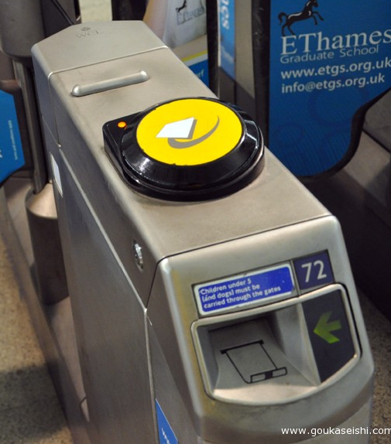
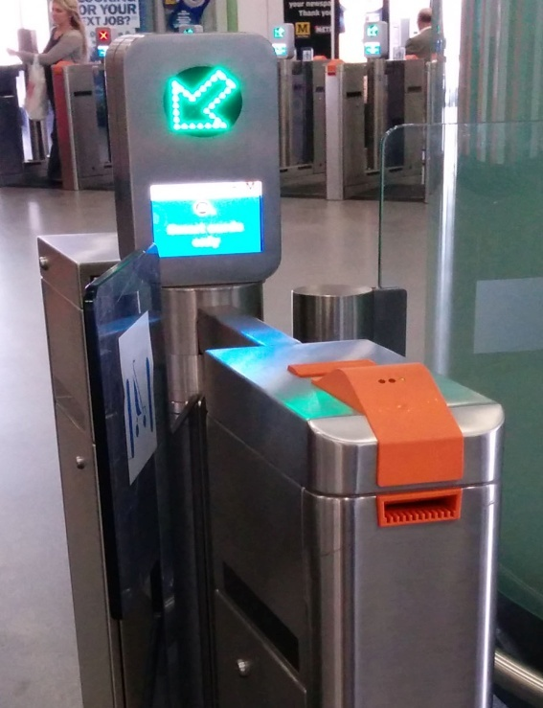
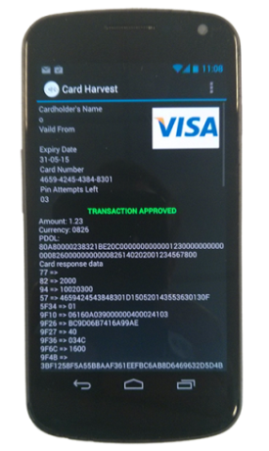
Contactless Attack Methods

