Slide 1

Using Instagram for Beginners

Slide 2
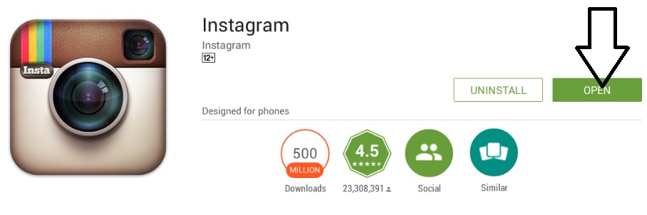
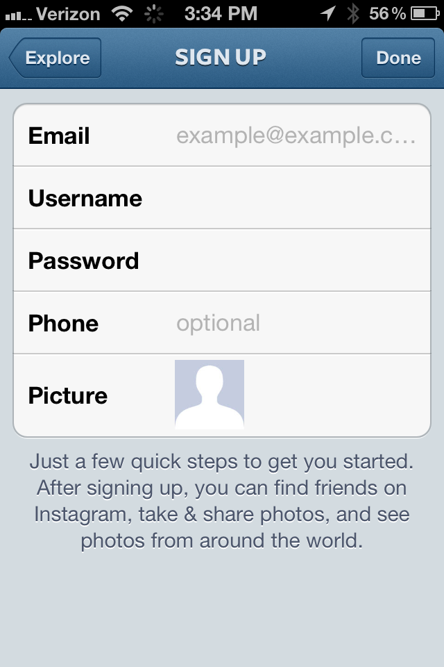
Get an Instagram Account
First download the app from the app store
Then after launching the application, create an account
If you don’t have an email click here for a video tutorial

Slide 3
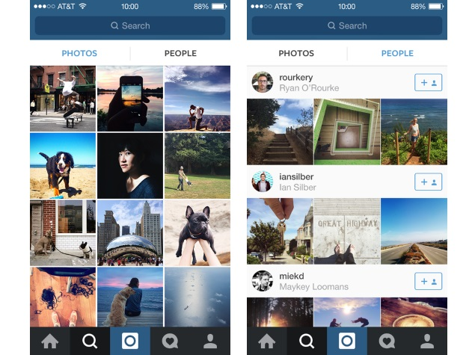
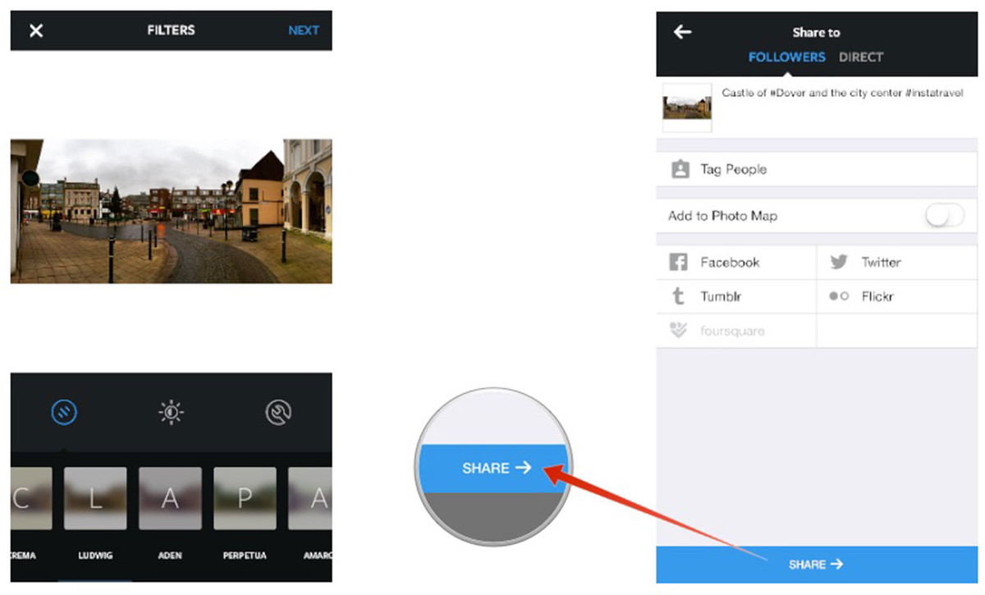
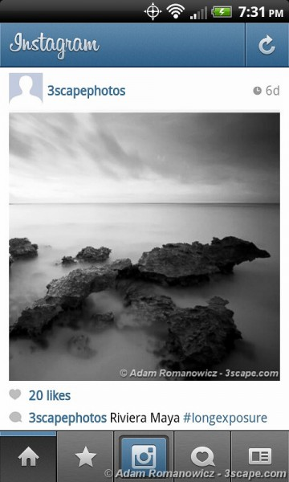
Navigating the App
You can put this on your timeline (followers) or send it to someone in particular (direct)
Here you can view notifications received
Click here to upload a picture
Here you can add a caption for your photo
Here you can use tools to edit the picture and add filters
You can tag friends here
And then share your picture here
Here you can see suggested pictures, videos, and people based on people you follow and liked history
Here you can search for account
Here is the button to access your profile
Here is the home screen button, where you can see posts from people you follow

