Slide 1
Dealing with Injury
A.Hooper1@newcastle.ac.uk
A.Points2@newcastle.ac.uk
Max.Stone@newcastle.ac.uk
Tracy.Donachie@newcastle.ac.uk
Amelia Hooper, Alice Points, Dr Max Stone, Dr Tracy Donachie

Slide 2
Presentation Overview
This presentation will introduce you to the psychological effects of injury.
Specifically, it covers the immediate responses following injury, the 3 phases of injury recovery, and how, as coaches, you can help athletes through the recovery process.
Finally, some recommendations will be presented to use immediately in your coaching of injured athletes.

Slide 3
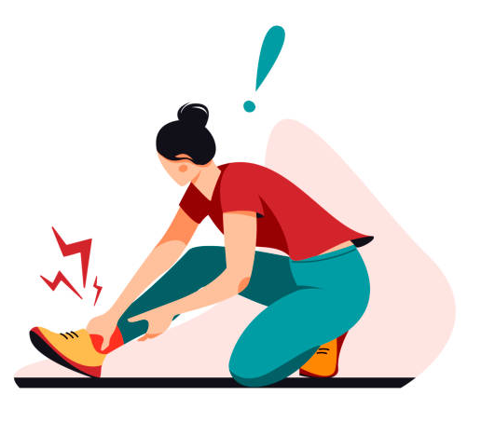
Injuries
An injury is a trauma to the body that results in at least temporary (but sometimes permanent) physical disability and inhibition of motor function.

Slide 4
Factors of Injury
There are many factors that play a role in an athlete being injured, and how they recover and return to full health.
However, this presentation will focus on the psychological factors of injury recovery.

Slide 5
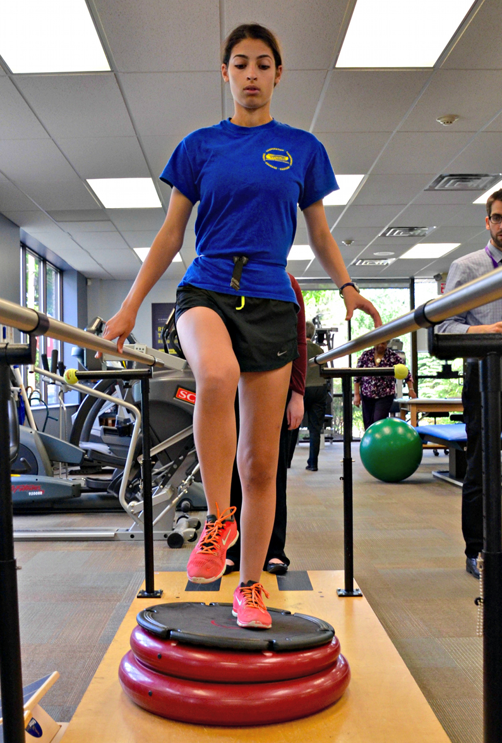
Why is this important?
Psychological factors play a crucial role in injury recovery.
Psychological reactions e.g., the feeling of dreams being shattered and fear of reinjury have been mentioned as stressors.
A stressor is any situation or event with the potential to cause stress.
Being familiar with these stressors is crucial for people working with injured athletes.

Slide 6
Immediate Responses Following Injury

Slide 7
Immediate Emotional Responses to Injury
You can expect injured individuals to exhibit 3 general categories of responses to injury:
Processing the injury.
Emotional and reactive behaviour.
Positive outlook and coping.
The period immediately after injury is characterised by the greatest level of negative emotions. This isn’t a linear process, and athletes may exhibit elements of all categories at varying times.

Slide 8

1. Processing the Injury
You can expect athletes to exhibit the following:
Focusing on information related to the pain of the injury.
Awareness of the extent of injury.
Asking how the injury happened.
Recognising the negative consequences of the inconvenience.

Slide 9
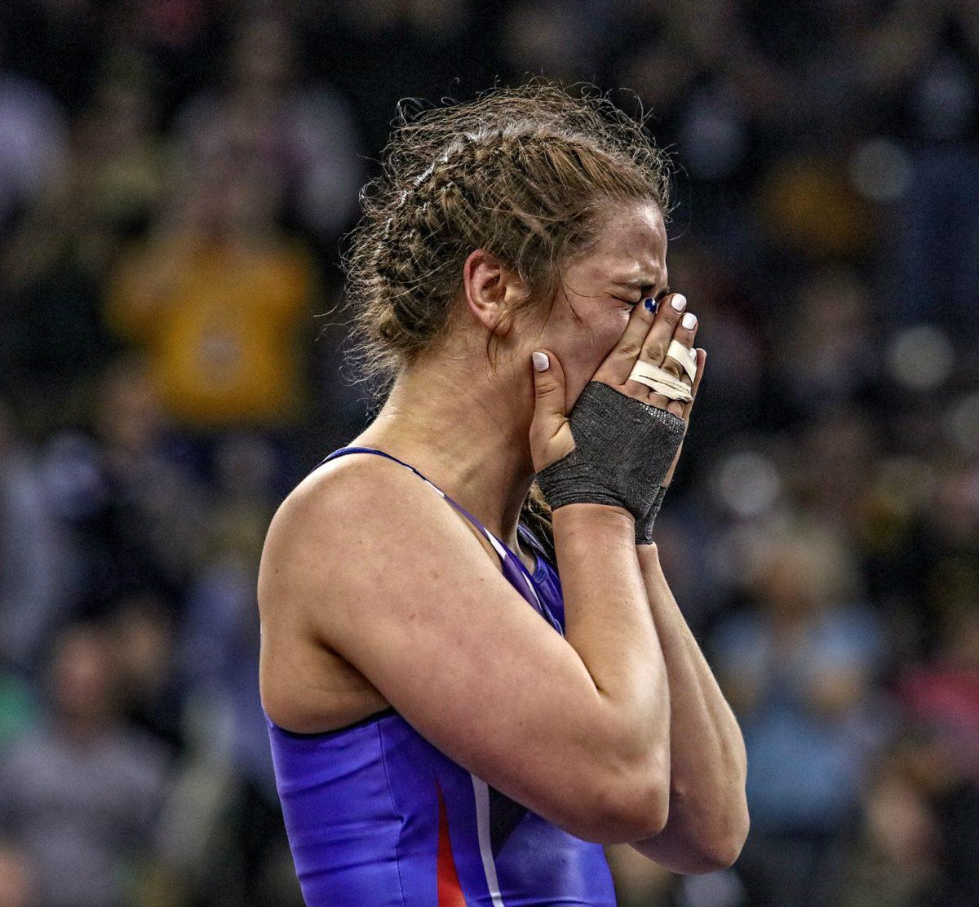
2. Emotional and Reactive Behaviour
You can expect athletes to be:
Emotionally agitated.
Emotionally depleted e.g., no interest in enjoyable activities such as their sport.
Feeling disconnected and isolated from the sport/team.
Shocked, in disbelief, denial or self-pity.

Slide 10

3. Positive Outlook and Coping
You can expect athletes to exhibit the following:
Acceptance of injury.
Initiated positive coping efforts.
A better attitude towards recovery and sport.
Optimistic and relieved to make progress.

Slide 11
Other Reactions to Being Injured
Identity Loss
Fear and Anxiety
Lack of Confidence
Performance Decrements
Group Processes

Slide 12
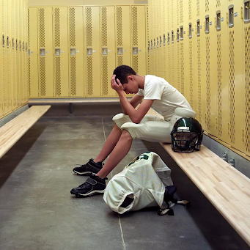
1. Identity Loss
Athletes who can no longer participate in sport have a loss of personal identity.
An important part of themselves (their sport) has been lost.
Research states that athletes with more motivation within themselves helped maintain an important part of themselves, but ONLY when the coach is supportive.

Slide 13
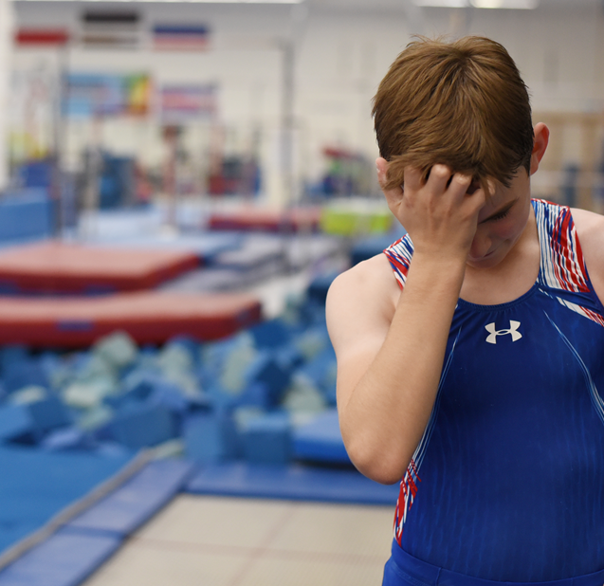
2. Fear and Anxiety
Athletes will worry about:
Whether they will recover.
Whether re-injury will occur.
Whether they will be replaced permanently in the line-up.
Due to increased free time, the athlete has a lot more time to worry.

Slide 14
3. Lack of Confidence
Given an inability to practice and compete and a deteriorated physical status, athletes may lose confidence after injury.
Lowered confidence can result in…
Decreased motivation.
Inferior performance.
Additional injury due to overcompensation.

Slide 15
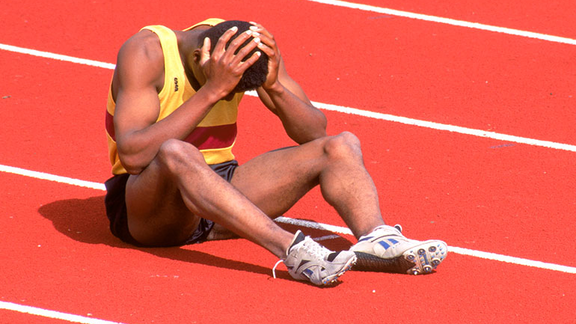
4. Performance Decrements
Athletes may have post-injury declines in performance due to lowered confidence and missed practice time.
Many athletes struggle to lower their expectations after an injury, and may expect to return to a pre-injury level.

Slide 16
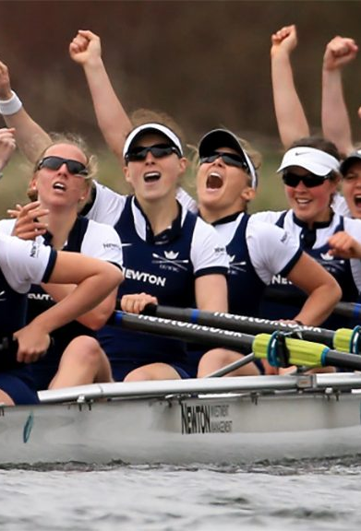
5. Group Processes
Injury to an athlete can affect group processes such as team cohesion. This can be positive or negative.
Positive effect: if a key individual gets injured, other players may rally around each other and contribute more, bringing the team closer together.
Negative effect: an injured player might interrupt the flow and teamwork that was developed through working with other players.

Slide 17
Summary of Initial Responses to Injury
There are 3 stages of emotional responses to injury:
Processing the injury.
Emotional and reactive behaviour.
Positive outlook and coping.
Other reactions include identity loss, a lack of confidence and effect on group processes.

Slide 18
Injury Recovery

Slide 19
3 Phases of Injury Recovery
Injury/Illness Phase
Rehabilitation and Recovery Phase
Return to Full Activity

Slide 20
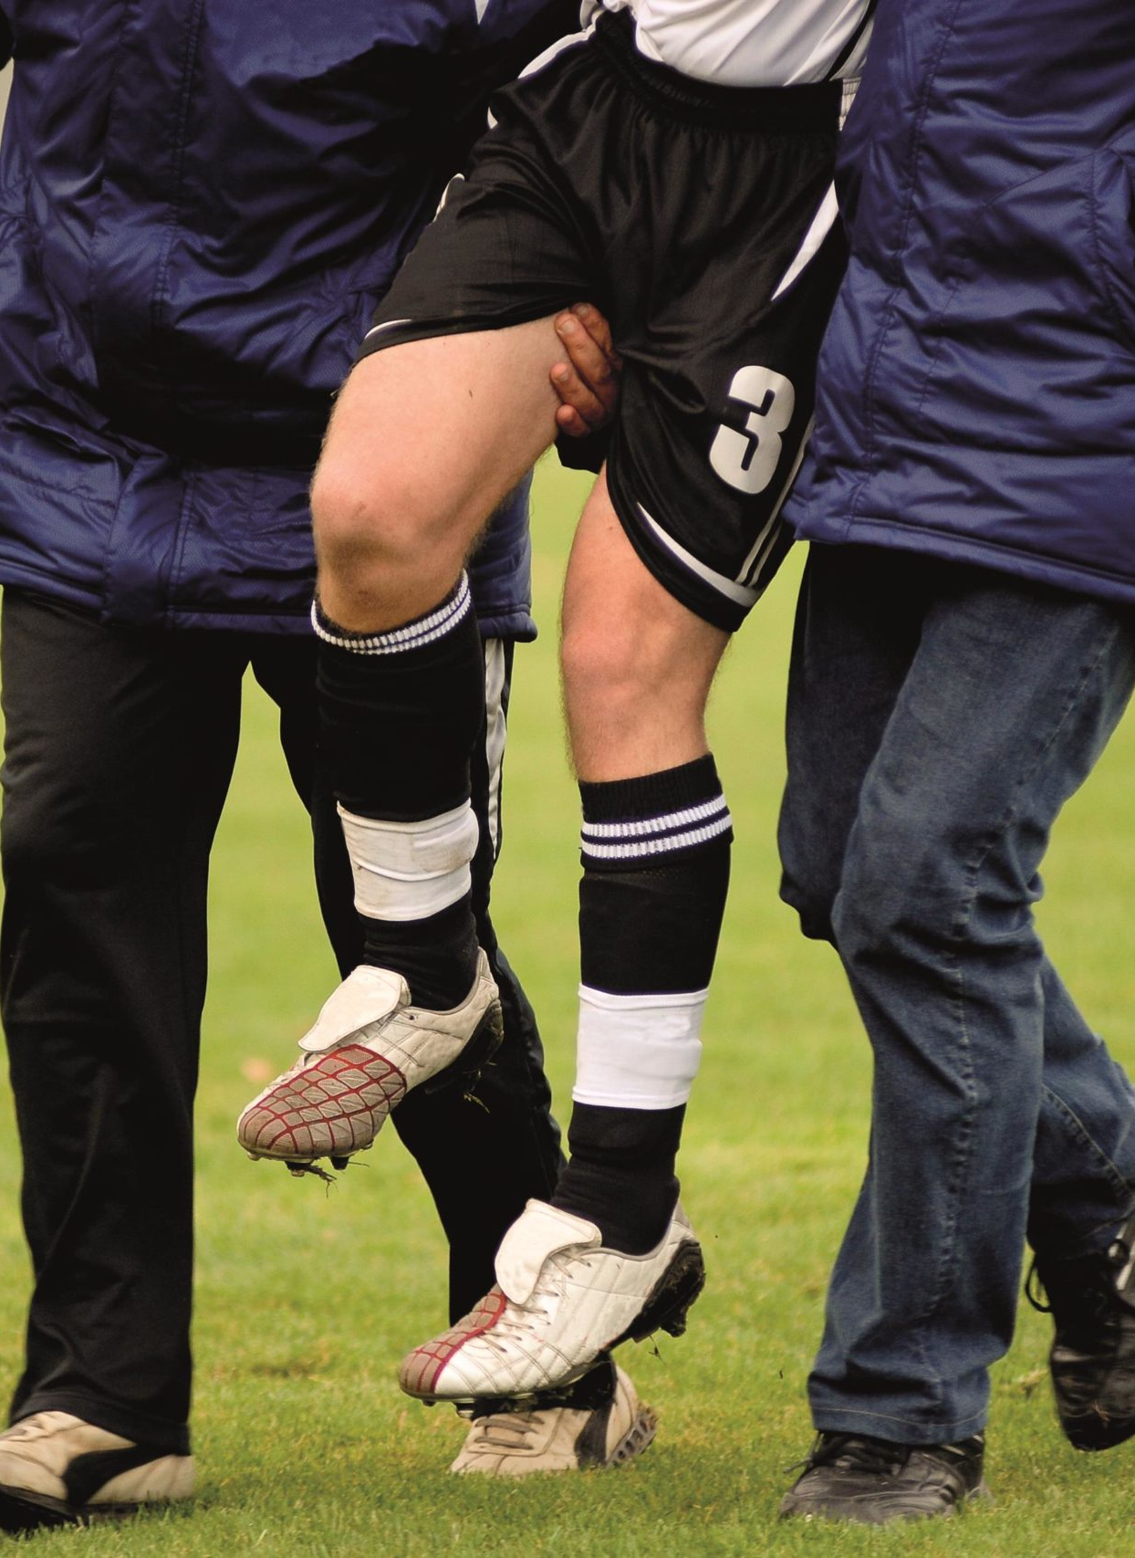
1. Injury/Illness Phase
The athlete's major source of stress is the initial uncertainty of an undiagnosed condition and implication of diagnosis.
Focus on helping the athlete deal with the emotions that accompany the onset and understanding.
Notes:
Create a positive environment, have discussions with the injured player, help reframe negative thoughts.

Slide 21
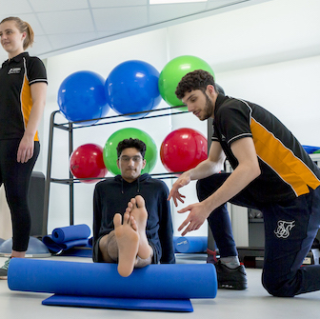
2. Rehabilitation and Recovery Phase
The athlete's major source of stress is the prolonged time out of sport and thoughts about not recovering.
Goal setting and maintaining a positive attitude are important in this stage.
Focus on helping the athlete sustain motivation and adherence to rehabilitation protocols.
Notes:
Set realistic goals for recovery and remind athlete their importance within the team to motivate the athlete.

Slide 22
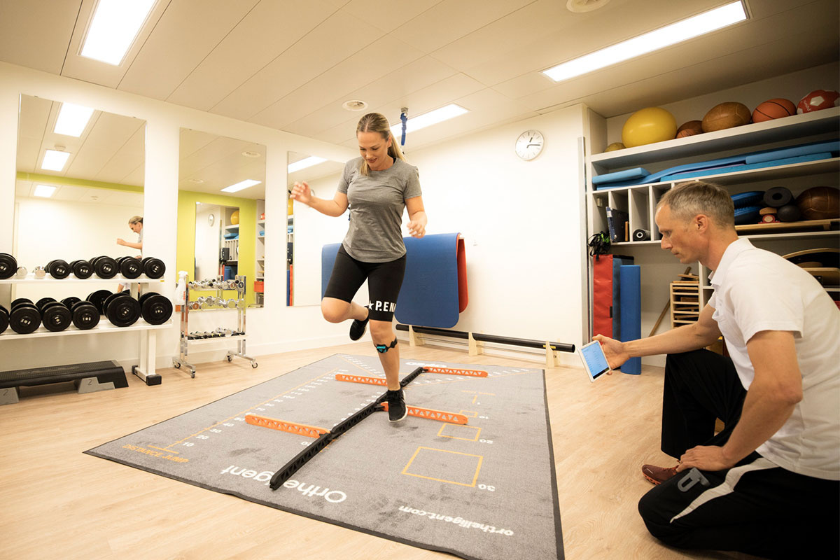
3. Return to Full Activity
After severe injury, return to normal competitive functioning is much harder than often thought and often takes considerable time.
Usually any time from 6 weeks to a full year.
From a coach perspective, support your athlete as they return to training, but remain cautious of reinjury.

Slide 23
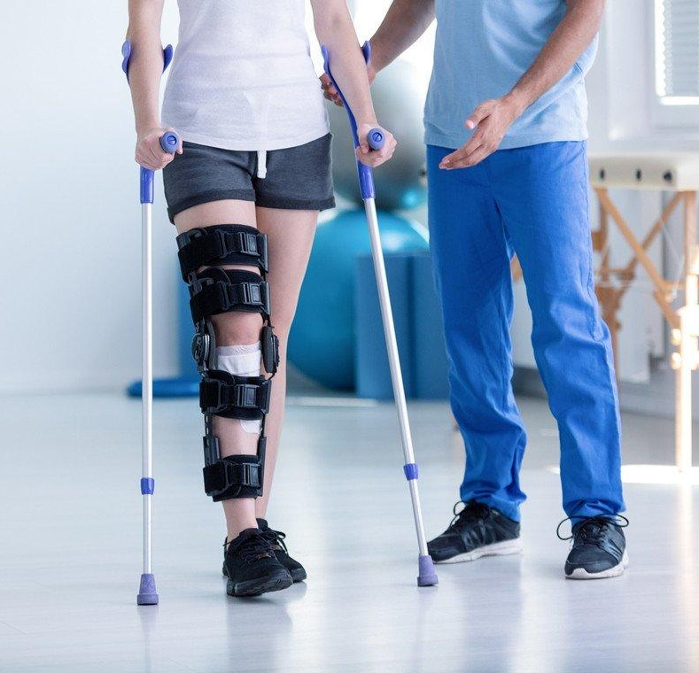
Adjustment
Most people work through their responses to injury, showing some negative emotions but not great difficulty in coping.
Some athletes however adjust poorly to their injuries.

Slide 24
Warning Signs of Poor Adjustment
Feelings of anger/dejection.
Obsession over the idea of returning to play.
Denial (e.g., ‘The injury is no big deal.’)
Repeatedly coming back too soon and becoming reinjured.
Guilt about letting the team down.
Withdrawal from significant others.
Rapid mood swings.
Statements indicating that recovery will not occur no matter what is done.

Slide 25
Recommendations for Coaches to Help Injured Players
Encourage use specific psychological coping skills.
Set expectations with the injured athlete about the injury, recovery process and setbacks.
Foster social support.
Ensure injured athletes are psychologically ready to return to play.

Slide 26

Teach Specific Psychological Coping Skills
The most important psychological skills for athletes to learn, in relation to recovery are:
Goal setting.
Imagery/visualisation.

Slide 27
Using Goal Setting
Goals should be performance based, i.e., focus on a specific standard to be achieved, and are typically quantified.
Goals should vary based on where the athlete is at in their recovery journey. E.g., during the rehabilitation/recovery phase, goals could be set about attending training/games to facilitate reintegration.
They should also be realistic for university athletes, who balance studies, sports and social lives.
An example of a realistic goal: In the rehabilitation phase, the athlete should attend physiotherapy twice a week.

Slide 28
Using Imagery/Visualisation
An injured player can:
Visualise themselves in game conditions to help maintain game skills.
Visualise the injured tissues healing and the growth of new, healthy tissue and muscle.
Imagery should be positive, which proves beneficial in self-confidence and motivation.
Imagery needs to replicate the task as closely as possible, with the injured player focusing on the same thoughts, feelings and actions as during the task.

Slide 29
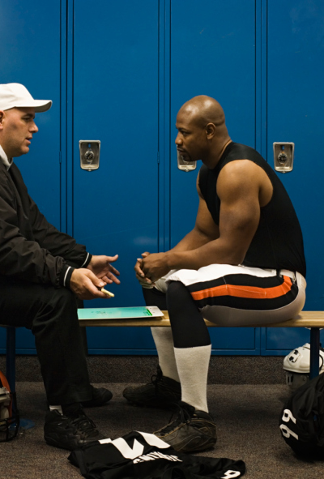
Set Expectations with the Injured Athlete
Tell the athlete what to expect and help them to understand it in practical terms.
Outline the recovery process.
Remind the athlete that it is likely they will face setbacks – encourage them to keep a positive attitude towards recovery.
Appoint a go-to person to help the athlete e.g., club welfare officer or team vice-captain.

Slide 30
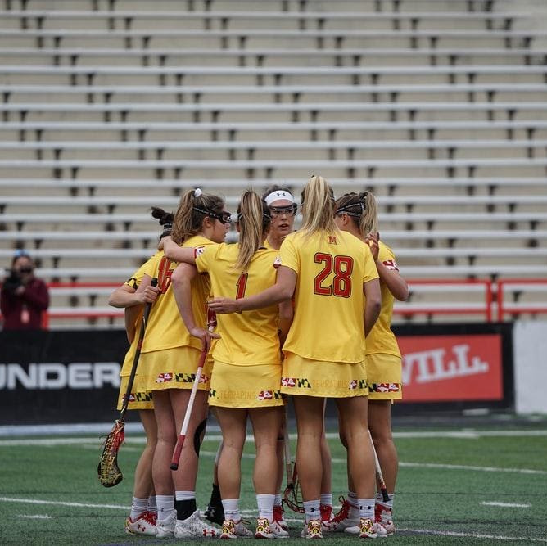
Foster Social Support
Social support comes from a wide variety of sources e.g., the coach, the wider team, the athlete's friends and family etc.
Recognise that the type of social support an athlete needs varies across rehabilitation phases.
For example, in the injury phase, information is needed for the athlete to understand their injury, given by a someone in the social support team. In the recovery stage, coaches should challenge and motivate athletes to adhere to the rehabilitation.

Slide 31
Ensure Injured Athletes are Psychologically Ready to Return
Psychological readiness is just as crucial as physical readiness.
Fear of reinjury was the most cited reason that influences athletes’ decision to return to sport.
Adapt the psychological techniques mentioned (imagery and goal setting) to focus on returning to sport to give the athlete confidence.

Slide 32
Summary
Support is needed throughout all three phases of injury: injury/illness phase, rehabilitation and recovery phase, return to full activity phase.
To help with injured athletes, coaches should:
Use psychological skills e.g., goal setting and visualisation.
Set expectations with the injured athlete about recovery.
Foster social support.
Ensure the athlete is psychologically ready to return.

Slide 33
Key Reads
Santi, G., & Pietrantoni, L. (2013). Psychology of sport injury rehabilitation: a review of models and interventions. Journal of Human Sport and Exercise, 8(4), 1029-1044.
Arvinen-Barrow., & Walker. (2013). The Psychology of Sport Injury and Rehabilitation. Abingdon, Oxon: Routledge.

Slide 34

Multimedia
The Sport Psych Show – Episode 192: Dr Keagen Hadley – Overcoming the Psychological Challenges of Injury

