Slide 1
Team Cohesion
A.Hooper1@newcastle.ac.uk,
A.Points2@newcastle.ac.uk, ​
Max.Stone@newcastle.ac.uk,
Tracy.Donachie@newcastle.ac.uk
AMELIA HOOPER, ALICE POINTS, DR. MAX STONE, DR. TRACY DONACHIE

Slide 2

What is Team Cohesion?
TEAM COHESION
  The process that reflects the tendency for a team to remain unified and stay united to achieve their goals.

Slide 3
Main Principles of Team Cohesion
How unified the team is.
How attracted the individual is to the team.

Slide 4
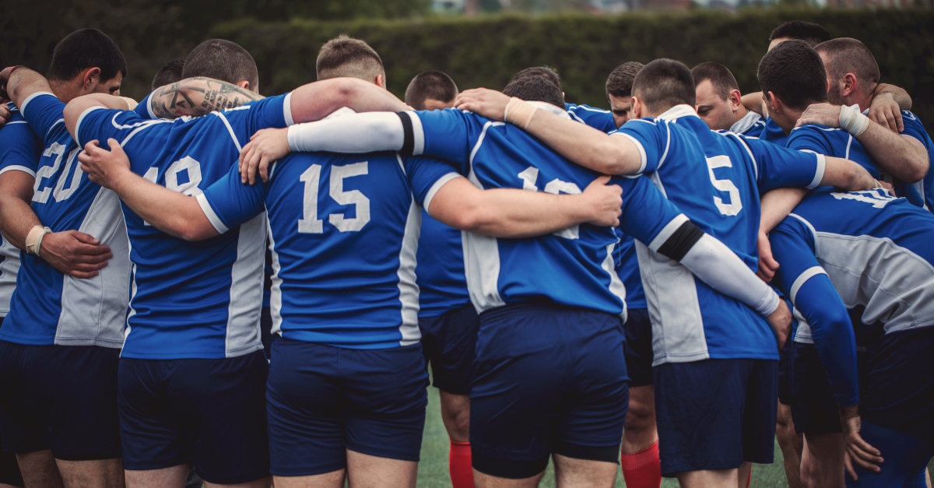
How Unified the Team is
This represents the closeness, similarity and bonding of the team members.
Focuses on the TEAM, not the individual.

Slide 5

Attraction to the Team
Represents the athlete's motivation to remain a part of the team.
Individual attractions represents the team member's feelings about the team, their personal involvement within the team and their involvement with other team members.
Focuses on the INDIVIDUAL, not the team overall.

Slide 6
Further Principles of Team Cohesion
Both main principles have an element of:
    Task Cohesion
    Social Cohesion

Slide 7
Task Cohesion
How well a team can work together to achieve common tasks and goals.
Look out for the following as signs of GOOD task cohesion:
Increased level of interaction and communication.
Increased willingness to achieve the same goal.
Appreciating the level of success whilst performing.
Look out for the following as signs of POOR task cohesion:
Lack of interaction.
Non-cooperative behaviours e.g., not passing the ball, not communicating.
Failures due to team disputes.

Slide 8
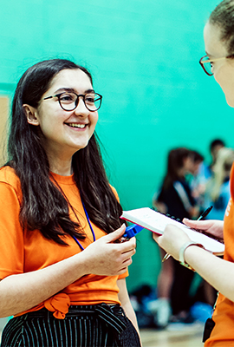
Social Cohesion
The social relationships between team members.
When the bond and interaction between the team is strong, the motivation and desire to succeed in a team is increased.
Why?
  Social praises and support.
Results in an increase their unique emotional well-being, self-esteem and confidence.

Slide 9
Putting it all Together...
How Unified the Team is-Task
Team feels unified in achieving its goals for the season.
    Attraction to the Team-Task
    Individual likes and/or personally resonates with the team's goals.
How Unified the Team is-Social
Team feels socially close.
Attraction to the Team-Social
Individual likes and/or personally resonates with the social element of the group.

Slide 10
Examples in Practice:
How Unified the Team is-Task
Team members have similarity in goals for the season e.g., a win over a close rival like Durham.
Attraction to the Team-Task
A team member feels positive that the team and can achieve promotion in BUCS this year.
How Unified the Team is-Social
Team members have a close bond within the team e.g., supporting each other after a loss.
Attraction to the Team-Social
A team member has made friendships from the team, which motivates them to continue to take part.

Slide 11

Why is Team Cohesion Important?
  Team cohesion is highly important for sports teams.
  Social and task cohesion are both important for overall team cohesion.
  Gender, athlete skill level and sport type impact team cohesion and subsequently, team performance.
  Higher levels of effort enhances team cohesion and performance.
  There is a circular relationship between performance and team cohesion (e.g., each one influences the other).

Slide 12
Four Factors Affecting Team Cohesion
  Team
  Environment
  Personal
  Leadership

Slide 13

1. Team
Team factors refer to the influences affecting a unified group.
Key team factors include team stability and shared experiences.
E.g., teams that are highly motivated, have confidence in the team, remain together for a long period of time and experience a series of successes or failures which unify the team, are more cohesive.
Notes:
TEAM CONFIDENCE: collective belief of all team members that they have the ability and capacity to work well as a team.

Slide 14
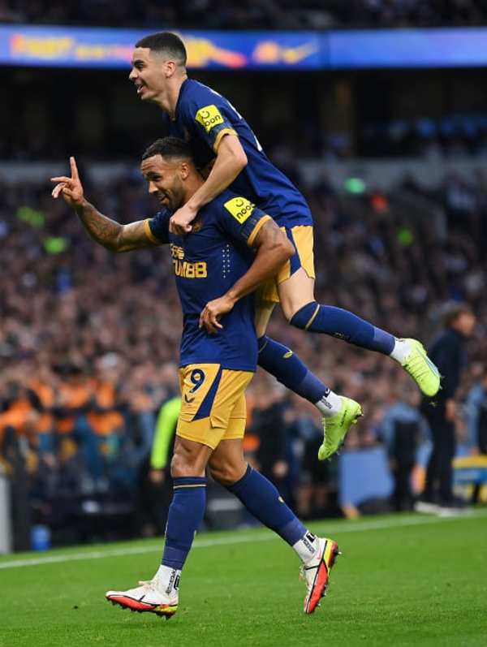
2. Environment
Environmental factors refer to the external influences on a team. They are the most general and remote.
Key environmental factors include the proximity and size of the team.
E.g., teams which have good quality interactions and share spaces, and are smaller in numbers are more cohesive.

Slide 15

3. Personal
Personal factors refer to each team member’s attributes.
Key personal factors include individual satisfaction and member similarity.
E.g., team members that share a similar goal will be more cohesive due to the development of close friendships.

Slide 16
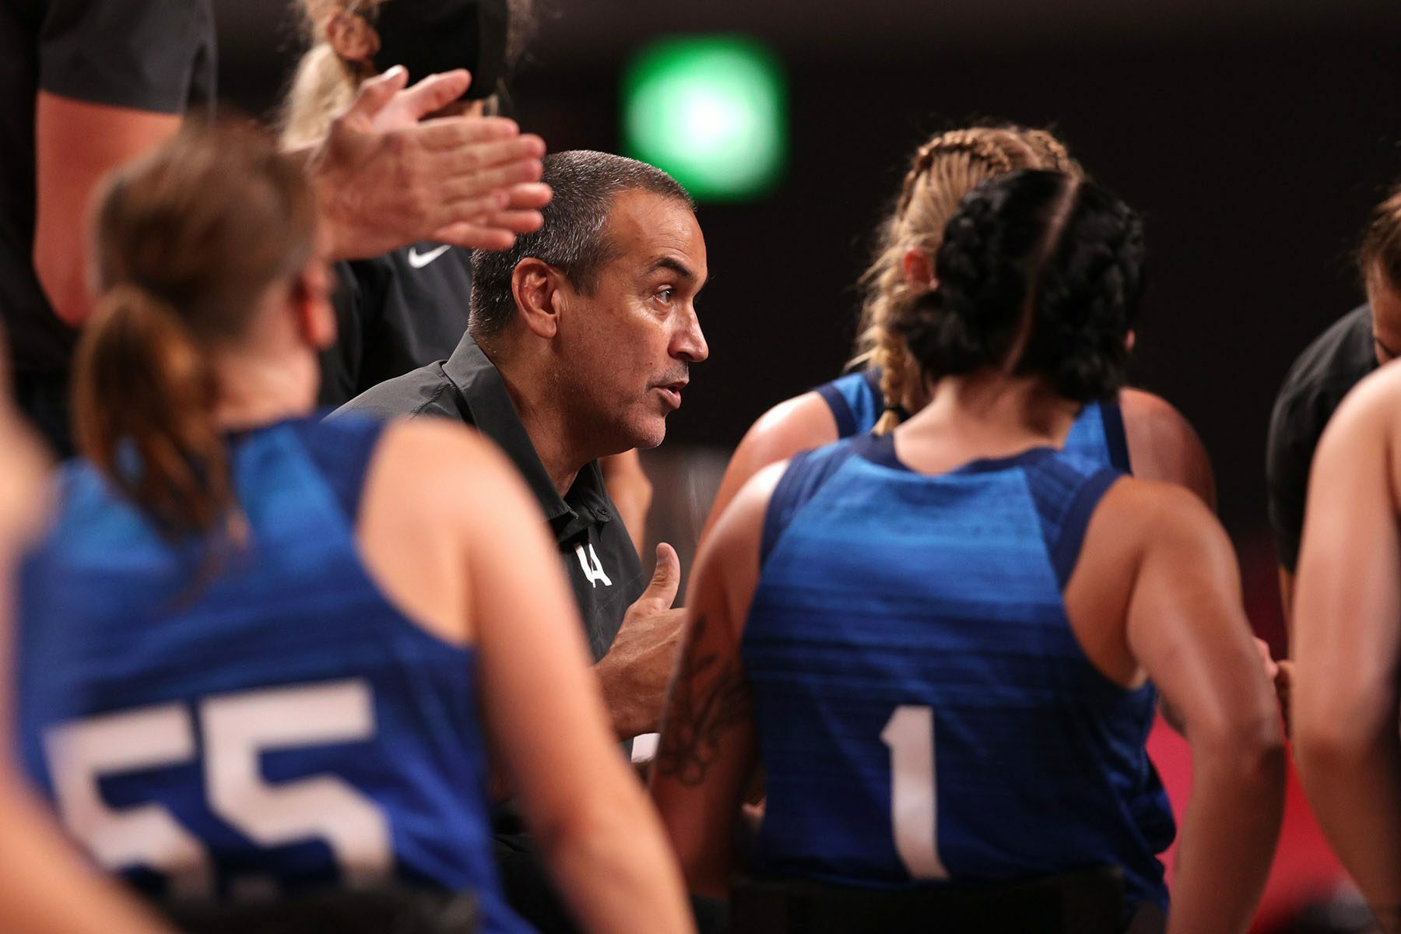
4. Leadership
Leadership factors refer to the coaches influence on the team.
Key leadership factors include style of leadership and clear communication with all team members.
E.g., coaches that clearly communicate team goals and tasks, and have a participative leadership style are more cohesive.

Slide 17
Summary of Overall Principles
To increase cohesiveness, we need to make team members more unified and attracted to the team.
Coaches can increase integration and attractions by changing:
  Team Dynamics
  Environmental Factors
  Personal Factors
  Leadership Factors

Slide 18
Key Recommendations
Communicate Effectively
Role Clarity and Acceptance
Goals and Objectives
Leadership

Slide 19
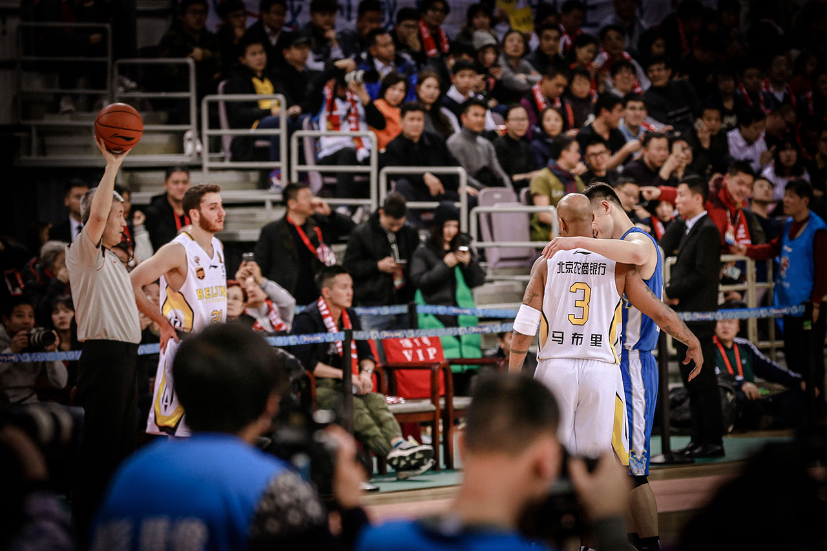
Communicate Effectively
An effective coach creates an environment where all athletes feel they can express their thoughts and feelings comfortably and appropriately. ​
A coach can:
  Offer informal and formal methods of communication to athletes e.g., team meetings.
  Encourage trust among teammates.

Slide 20
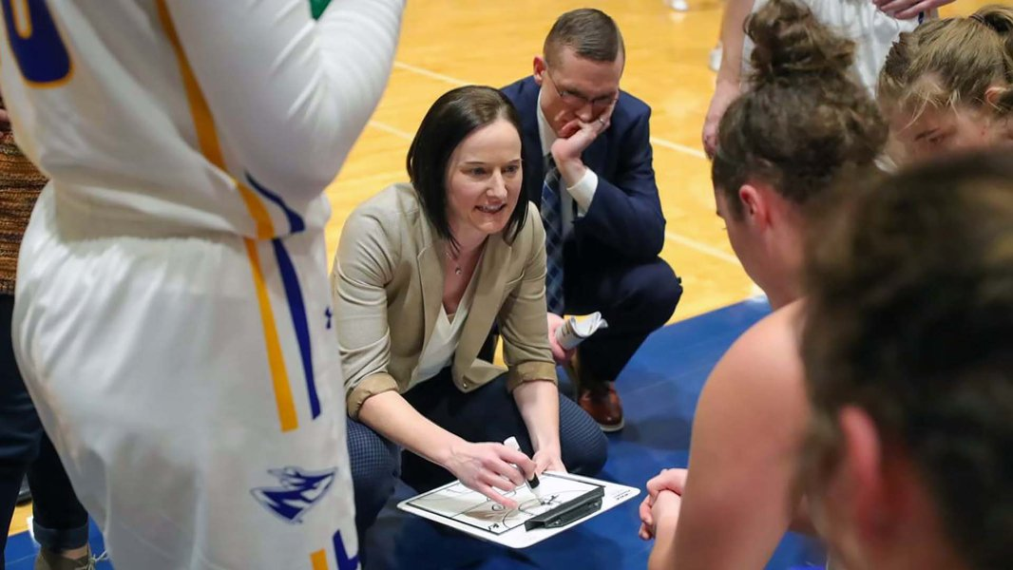
Role Clarity and Acceptance
When team members clearly understand their role in the team, understand and accept their role within the team, cohesiveness is enhanced.
A coach can:
Ensure all team members understand their role in the team
Use team leaders to reiterate roles and ensure understanding of roles for new team members.

Slide 21

Goals and Objectives
  Goals keep the team focused and have a positive effect on team performance.
  Team goals should be relevant to individual goals, otherwise team members lose focus.
A coach (alongside the team) should:
  Establish a long-term goal first e.g., promotion in BUCS league.
  Identify paths to achieve this long-term goal.
  Monitor progress made.
  Reward progress towards the goal.
  Foster collective team confidence.

Slide 22
Goal Setting Pathway
Pathways should include:
Short-term outcome goals.
Short-term performance goals.
Short-term process goals.
Outcome Goals – goals that focus on the end-point of an event e.g., winning a match.
Performance Goals – goals that identify a specific standard to be achieved e.g., catching 70% of throws to you in lacrosse.
Process Goals – goals focus on improving strategy and form to perform skills successfully e.g., a rugby player perfecting their form for a drop goal.

Slide 23

Example of Goal Setting Pathway
Sport: Basketball
Long Term Goal – Promotion in BUCS League.
Pathway:
  Short-term outcome goal: win 4 matches out of 6.
  Short-term performance goal: team free throw shooting percentage above 80%.
  Short-term process goal: reducing the number of turnovers.

Slide 24
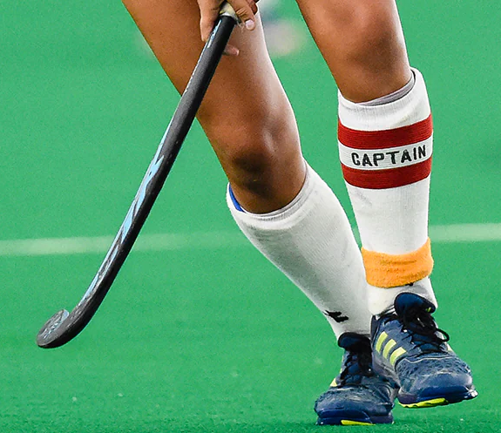
Leadership
Adopt a participative leadership style:
  Take an “asking” approach to the team.
  Adjust the training routine if team members struggle.
  Incorporate teams opinions and approach into decision making.
Leaders who can adapt their leadership style to suit the situation allows the team to feel more cohesive, interact effectively and always work together to achieve their team goal.

Slide 25

Summary
Team cohesion is split into team integration and individual attractions to the team.
  Both have an element of task and social cohesion.
Personal, team, environmental and leadership factors all affect team cohesion.
Team cohesion can be improved by:
  Communicating Effectively
  Considering a Leadership Style
  Setting Goals and Objectives
  Clarifying Roles in the Team

Slide 26
Key Reads
Eys, M., & Kim, J (2017). Team Building and Group Cohesion in the Context of Sport and Performance Psychology. Oxford Research Encyclopedia of Psychology.
  https://oxfordre.com/psychology/view/10.1093/acrefore/9780190236557.001.0001/acrefore-9780190236557-e-186
Eys, M. A., & Brawley, L. R. (2018). Reflections on cohesion research with sport and exercise groups. Social and Personality Psychology Compass, 12(4), e12379.

Slide 27

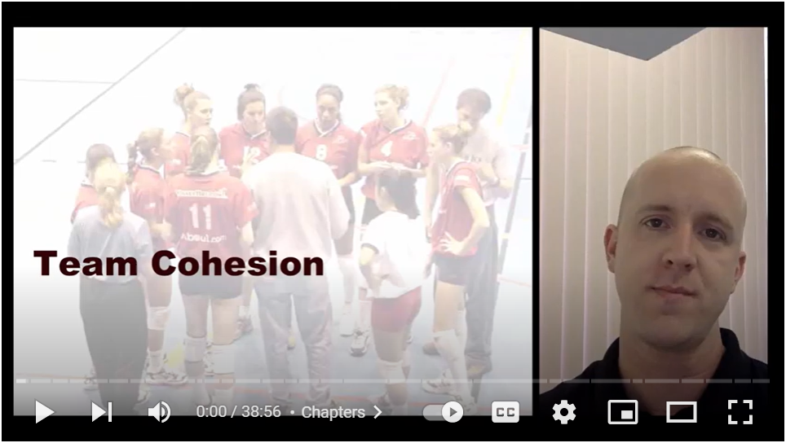
Multimedia
Episode 189: Why Teamwork Breaks Down (and ways to fix it).
Available on Spotify.
YouTube: Richard Keegan: Team Cohesion in Sport Psychology

