Slide 1

HRV Biofeedback Clinic: An overview
Alice Points, Amelia Hooper, Dr Max Stone, Dr Tracy Donachie
A.Points2@newcastle.ac.uk
A.Hooper1@newcastle.ac.uk
Max.Stone@newcastle.ac.uk
Tracy.Donachie@newcastle.ac.uk

Slide 2
Thank you for your participation!
Overview of this presentation:
Aim: to give you some insight into why you will be doing the clinic and what it entails.
What we will cover:
The body’s stress response.
What is biofeedback and how can we use it to control the stress response?
What is heart rate variability (HRV)?
What is resonant breathing?
How and why HRV biofeedback works.
Overview of the biofeedback clinic procedure.

Slide 3
The Autonomic Nervous System
The autonomic nervous system is responsible for unconscious bodily functions e.g., breathing and digestion.
It is made up of two different nervous systems – SNS and PNS.
Autonomic Nervous System
Active when stressed
Active when relaxed
Sympathetic
Nervous System (SNS)
Parasympathetic Nervous System (PNS)
When doing HRV biofeedback: 1) the SNS stress response is reduced and 2) the PNS relaxation response is activated.

Slide 4
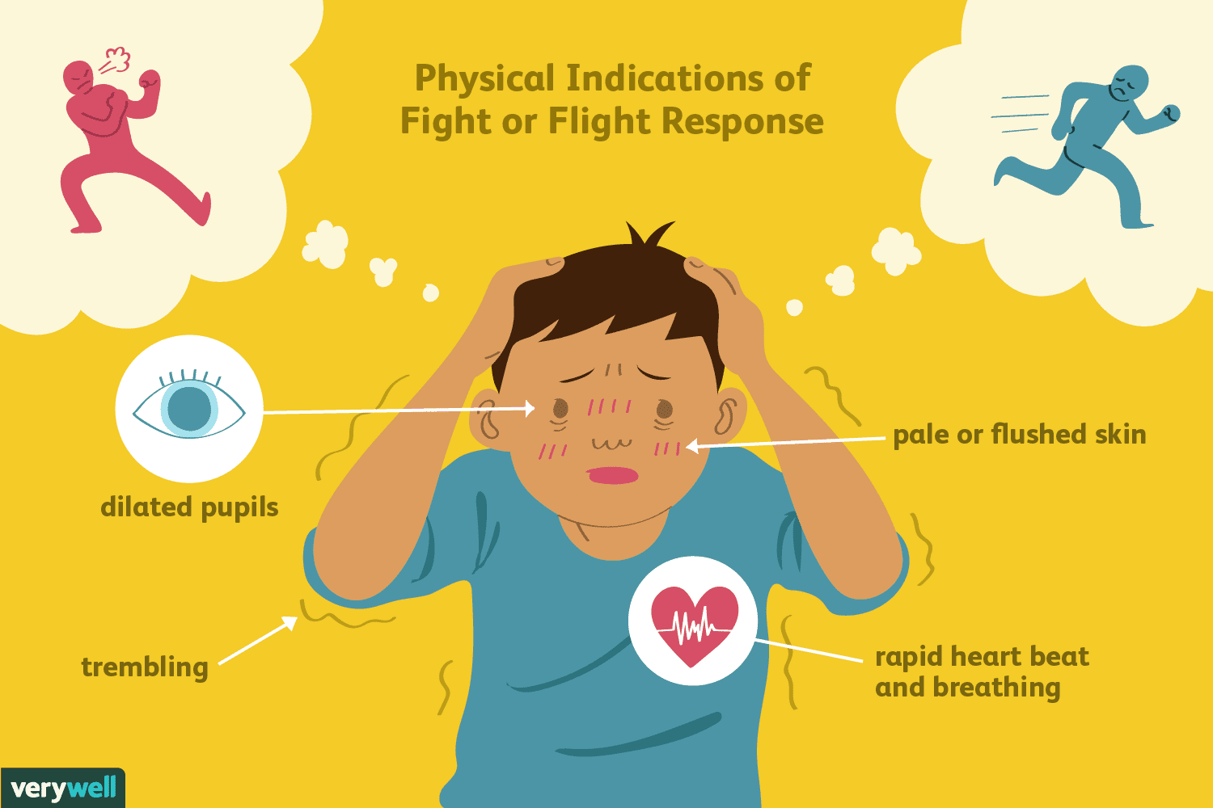
The Stress Response
AKA the fight or flight response!
A physiological reaction to an event that is perceived as stressful or frightening.
  This could be anything from encountering a poisonous snake to sitting end of semester exams.
Begins when hormones such as adrenaline are released from glands in the sympathetic nervous system.
Features of the stress response:
  Increased heart rate.
  Increased respiration.
  Increased sweating.
  Tense muscles.
  Dilated pupils.
So how can HRV reduce this stress response?...

Slide 5
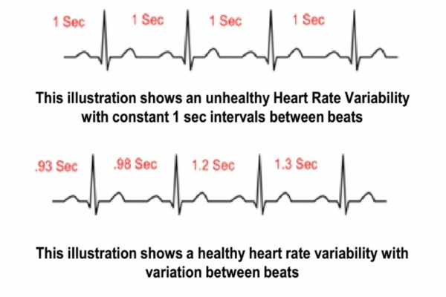
What is heart rate variability (HRV)?
HRV: a measure of the variation in time between each heartbeat.
High HRV is associated with calmness and better general health, as it indicates greater ability for the body to regulate itself.
So, how can we increase HRV?
HRV can be increased with exercise and biofeedback.
Notes:
IF SPEAK: say “high resting HRV” for point 3

Slide 6
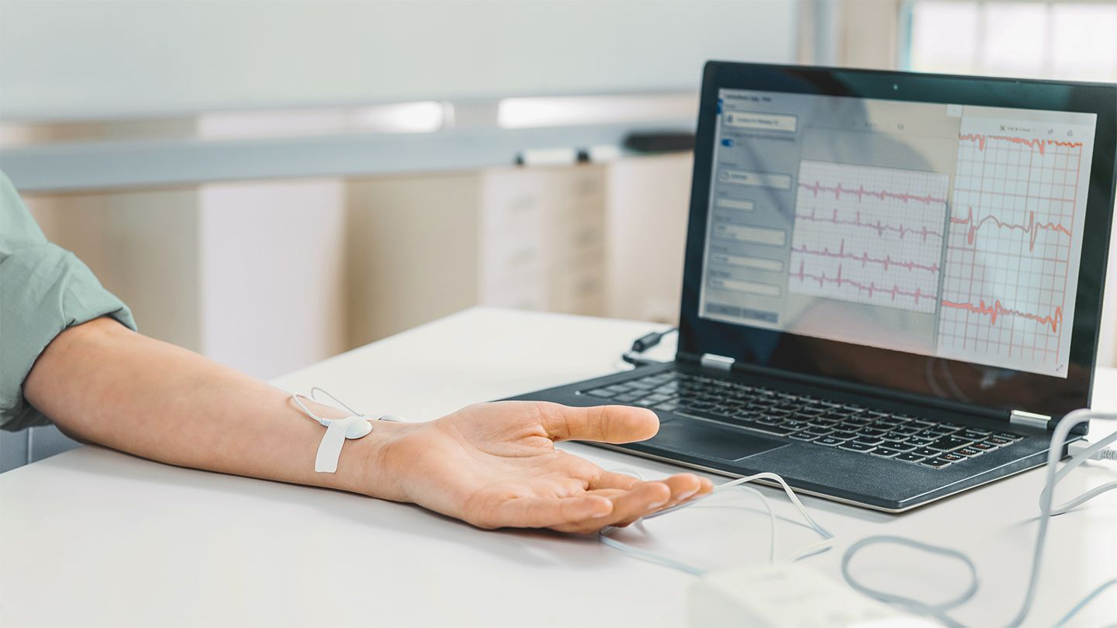
How can biofeedback help?
What is biofeedback?
Connect body to electrical sensors, receive live information about your bodily functions e.g., your heart rate.
How to do we apply it to the stress response?
We use this info to regulate the sympathetic nervous system by controlling the body’s responses to stress (e.g., by lowering HR, releasing muscle tension, regulating breathing frequency).
This may help improve physical/mental performance e.g., by reducing stress/encouraging relaxation.

Slide 7
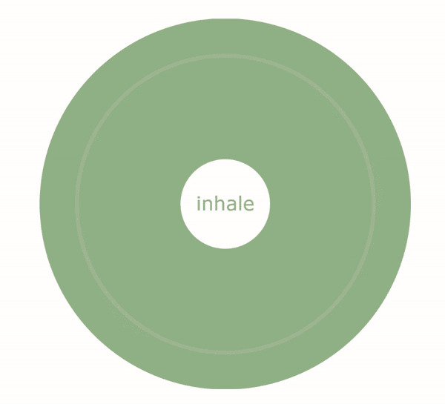
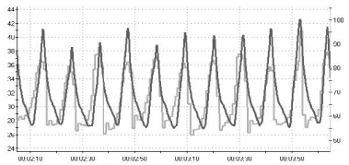
HRV Biofeedback: The What
HRV biofeedback is a training technique in which the subject observes both their respiration and heart rate on a monitor, to try to synchronize the two graphs and so breathe at the body’s resonant frequency.
Resonant Frequency:
A specific breathing frequency where HRV is maximised
Usually approx. 6 breaths per minute.

Slide 8
HRV Biofeedback: Aim
To teach you how to breathe at your resonant frequency.
Resonant frequency breathing...
  Increases HR during inhalation and decrease HR during exhalation to increase HRV.
  Maximises blood pressure regulation.
  Stimulates body pathways involved in mood regulation.
But what’s the point of all this?...

Slide 9
HRV Biofeedback: Possible benefits
Research shows resonant frequency breathing can help to improve emotional regulation, and manage the negative side effects of stress and anxiety.:
Following this clinic, you may be able to use the resonant breathing technique on demand to regulate your arousal when faced with stressors, such as competitions or exams, so helping you perform to the best of your ability.
Notes:
POTENTIAL PORGES REFERENCE: Porges, S. W., Doussard‐Roosevelt, J. A., Portales, A. L., & Greenspan, S. I. (1996). Infant regulation of the vagal “brake” predicts child behavior problems: A psychobiological model of social behavior. Developmental psychobiology, 29(8), 697-712.

Slide 10
Brief overview of clinic
Heart rate variability (HRV) biofeedback clinic.
Six sessions held weekly on a Thursday afternoon for 6 weeks.
Short psychological questionnaires at the start, end, and 6 weeks post clinic.
Optional follow-up focus group.
Held in Dame Margaret Barbour Building at Newcastle University.
Completely confidential and anonymous.

Slide 11
Biofeedback clinic procedure
At the beginning of each session: Collect information on the amount of sleep/food/water/caffeine intakes.
Home practice between sessions: Try and do at least 5-10 mins of daily resonant frequency breathing (but feel free to do more if wanted!). We will set you up with a smartphone app so you can do the breathing at home.
Session 1 (~45mins): collect physical baseline measures (e.g., resting HR) and determine resonant frequency.
Session 2 (~30mins): fine-tune resonant frequency.
Session 3 (~30mins): resonant frequency accuracy tests and paced breathing.
Session 4 (~30mins): resonant frequency accuracy tests and paced breathing.
Session 5 (~30mins): resonant frequency accuracy tests and paced breathing.
Session 6 (~15mins): recollect physical measures and complete Qualtrics questionnaire.
6 weeks post-clinic: complete Qualtrics questionnaire.
(Optional) Focus group: Open discussion for feedback.

Slide 12


Application for at-home Practice
iBreathe (iOS) Breathe (Android)

Slide 13
Do I need to do anything before the sessions?
Arrive 5 minutes early.
Wear comfortable clothing.
Try to avoid consuming food and water directly before the session.
Please avoid consuming caffeine a few hours before the session.
Please download the relevant smartphone app prior to coming for the first session.
Please notify us via email/text ASAP if you are unable to make the session.
We will contact you via email to arrange a time for your first biofeedback session.

Slide 14
Any questions?
A.Points2@newcastle.ac.uk
A.Hooper1@newcastle.ac.uk
Supervisors: Dr Max Stone (Max.Stone@newcastle.ac.uk) and Dr Tracy Donachie (Tracy.Donachie@newcastle.ac.uk)

Slide 15
References
The protocol we will be following:
Gross, M. J., Shearer, D. A., Bringer, J. D., Hall, R., Cook, C. J., & Kilduff, L. P. (2016). Abbreviated resonant frequency training to augment heart rate variability and enhance on-demand emotional regulation in elite sport support staff. Applied psychophysiology and biofeedback, 41(3), 263-274.
Other references:
Cannon, W. B. Bodily changes in pain, hunger, fear and rage. New York: Appleton, 1920.
Futterman, A. D., & Shapiro, D. (1986). A review of biofeedback for mental disorders. Psychiatric Services, 37(1), 27-33.
Kim, S., Rath, J. F., McCraty, R., Zemon, V., Cavallo, M. M., & Foley, F. W. (2015). Heart rate variability biofeedback, self-regulation, and severe brain injury. Biofeedback, 43(1), 6-14.
Musselman, D. L., Evans, D. L., & Nemeroff, C. B. (1998). The relationship of depression to cardiovascular disease: epidemiology, biology, and treatment. Archives of general psychiatry, 55(7), 580-592.
Prinsloo, G. E., Derman, W. E., Lambert, M. I., & Laurie Rauch, H. G. (2013). The effect of a single session of short duration biofeedback-induced deep breathing on measures of heart rate variability during laboratory-induced cognitive stress: a pilot study. Applied psychophysiology and biofeedback, 38(2), 81-90.
Tabachnick, L. (2015). Biofeedback and anxiety disorders: a critical review of EMG, EEG, and HRV feedback. Concept, 38.
Thayer, J. F., Åhs, F., Fredrikson, M., Sollers III, J. J., & Wager, T. D. (2012). A meta-analysis of heart rate variability and neuroimaging studies: implications for heart rate variability as a marker of stress and health. Neuroscience & Biobehavioral Reviews, 36(2), 747-756.

